Slide 1

Hotel Aggregator Analysis
Power BI
By Aml Yasser

Slide 2
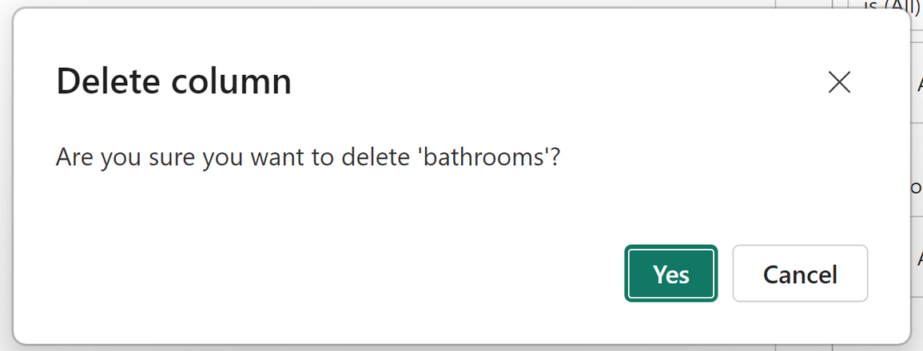
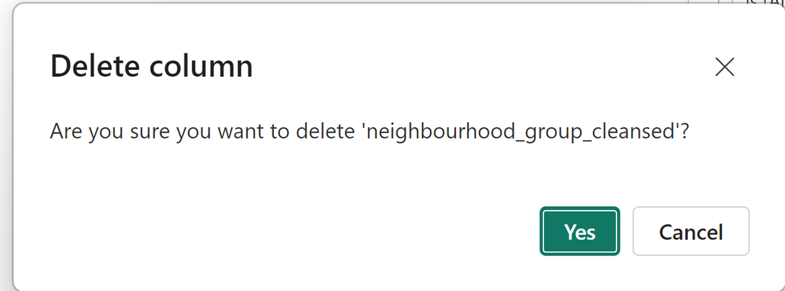
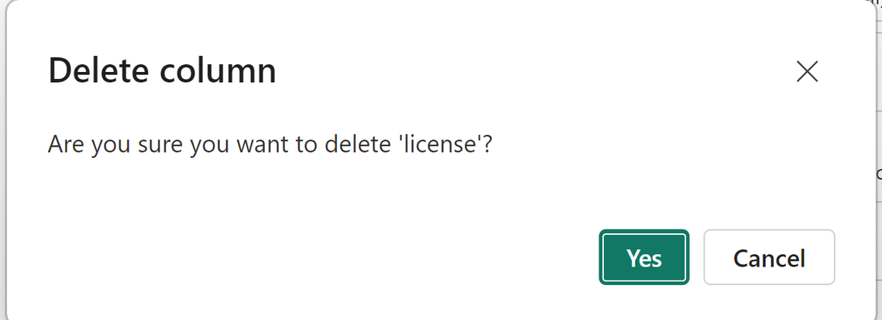
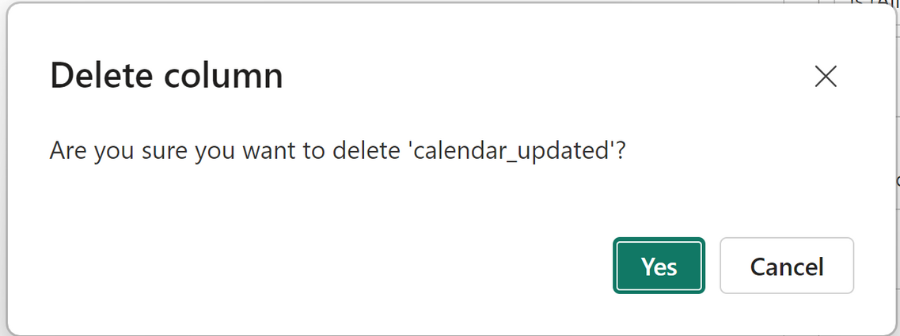
Cleaning Data
1- Delete empty columns

Slide 3
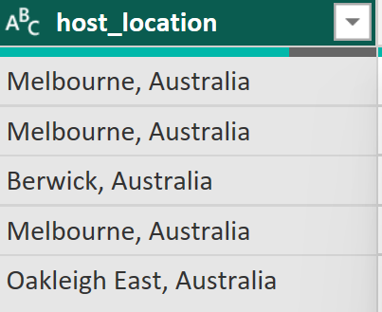

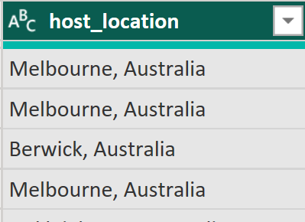
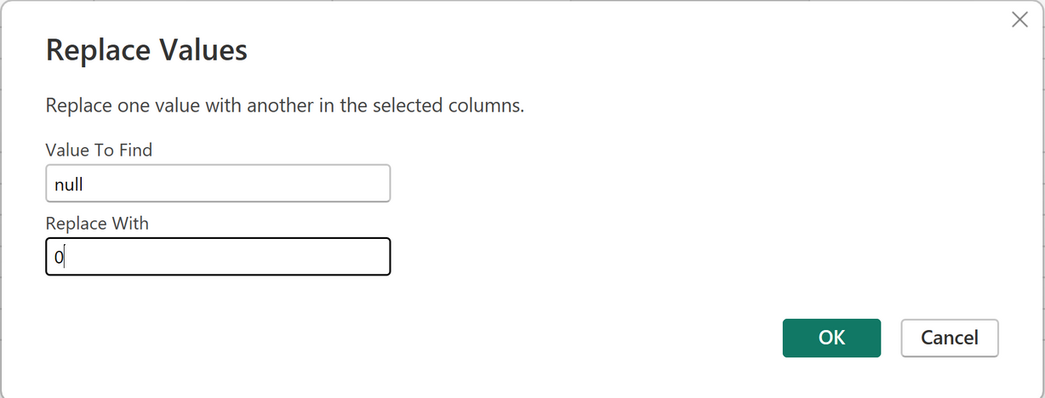
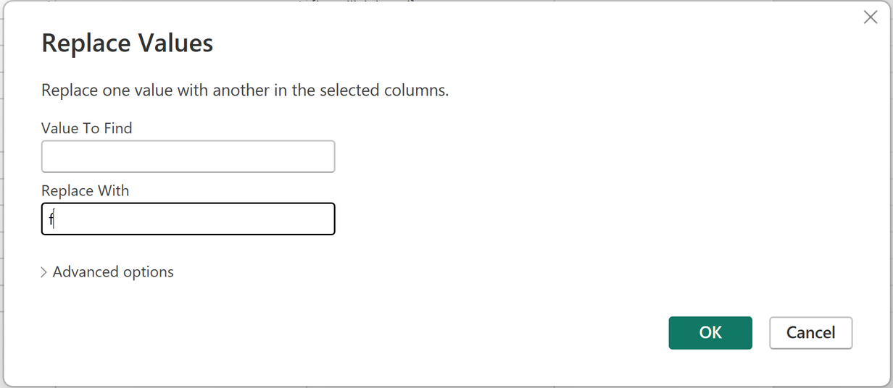
Cleaning Data
2- Replace Values
null values
empty strings

Slide 4
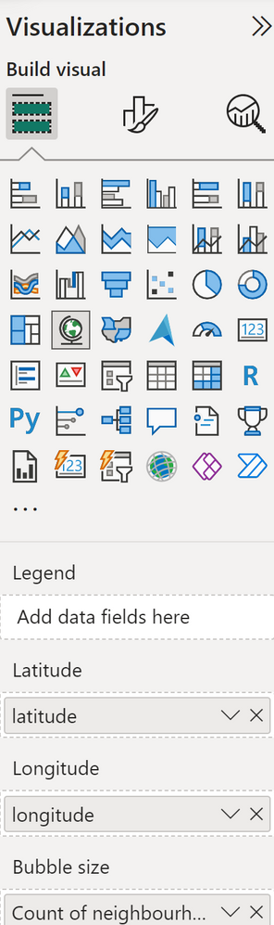
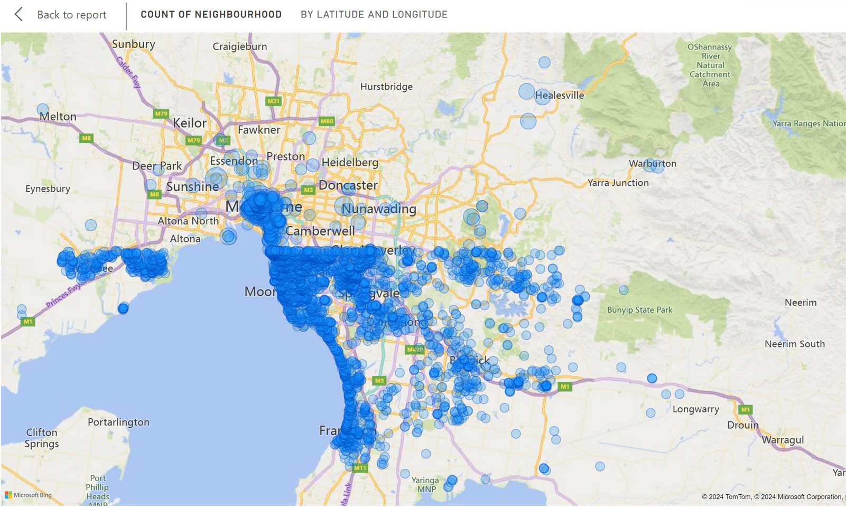

1. Geographical Insights:
Visualize the distribution of listings on a map to identify popular neighborhoods.

Slide 5
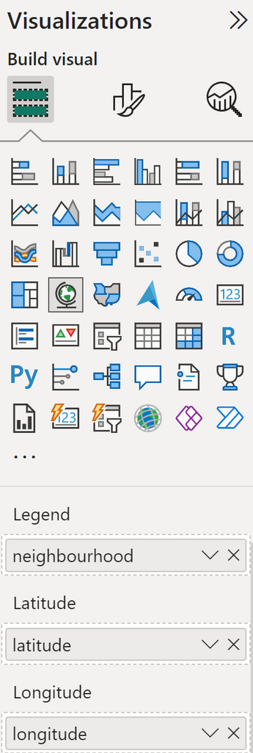
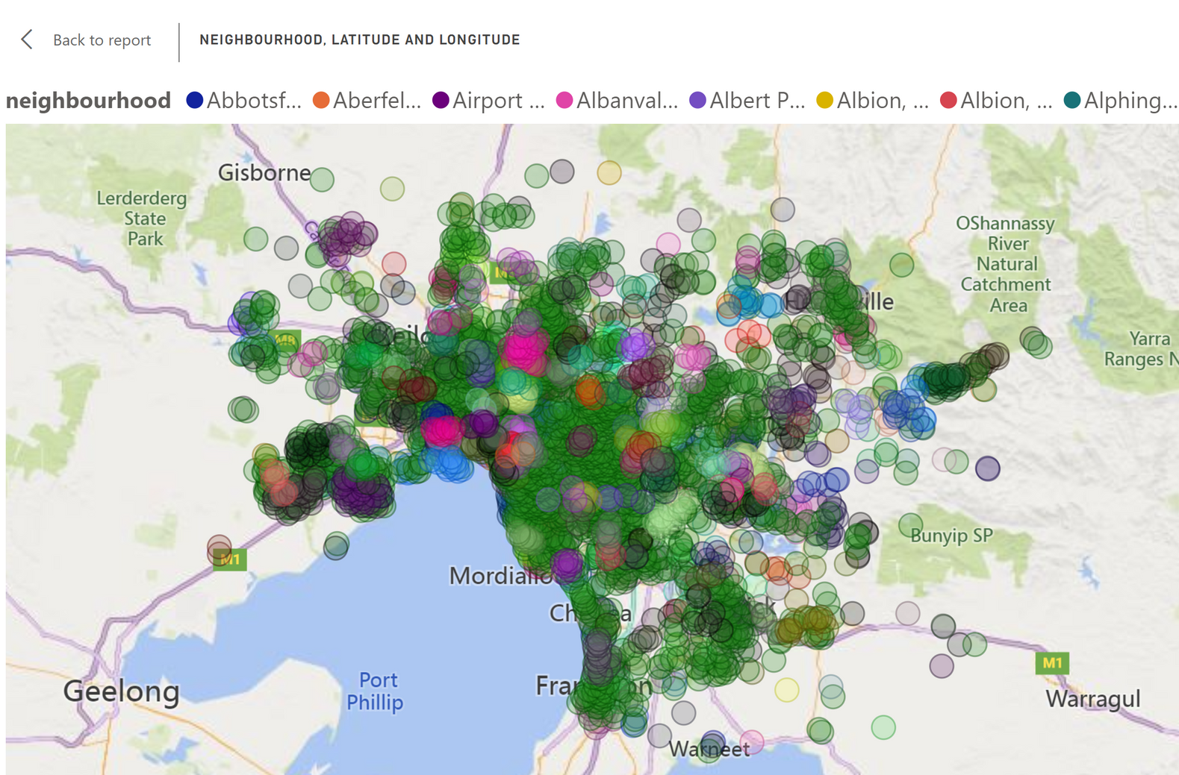
1. Geographical Insights:
Visualize the distribution of listings on a map to identify popular neighborhoods.

Slide 6
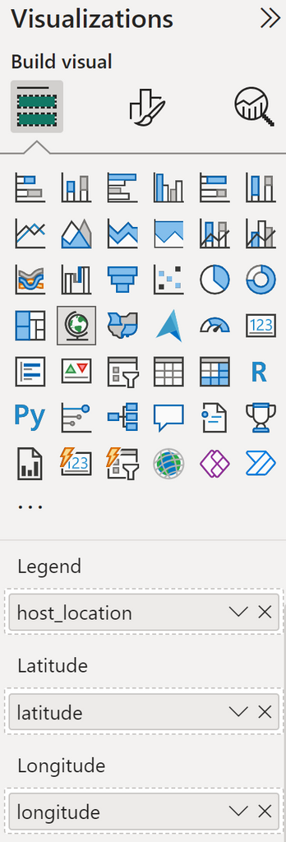
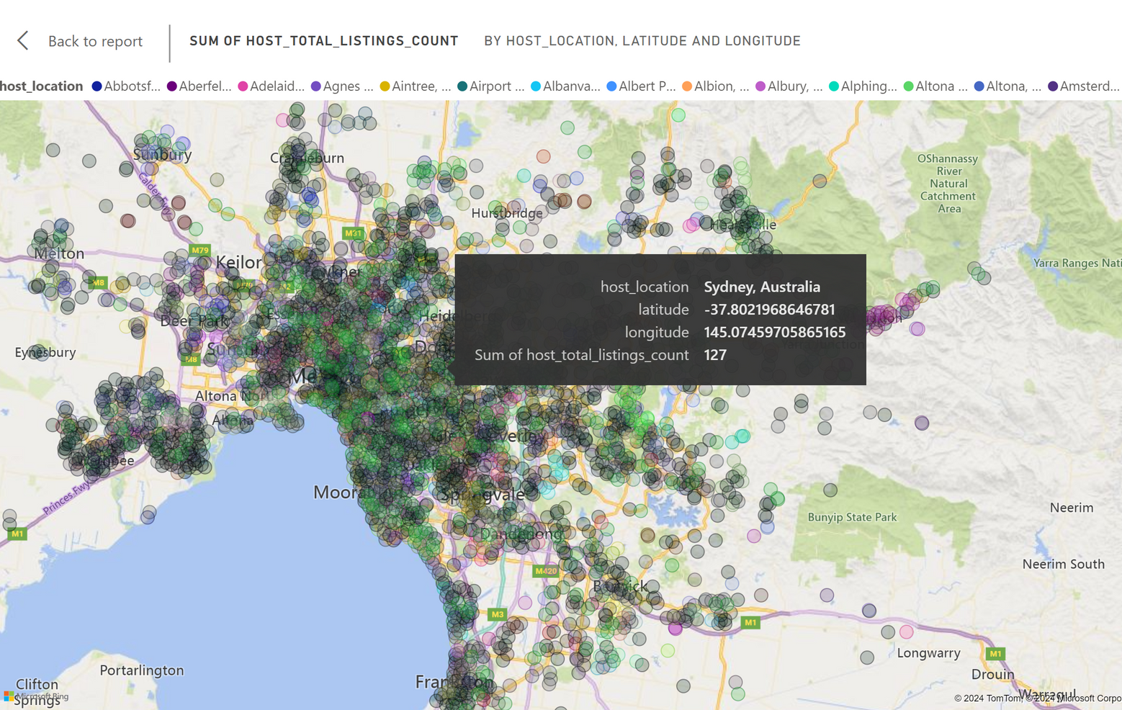
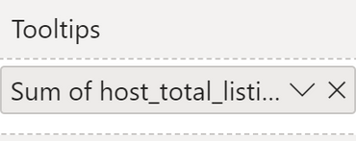
1. Geographical Insights:
Explore the geographical concentration of listings and host locations.

Slide 7
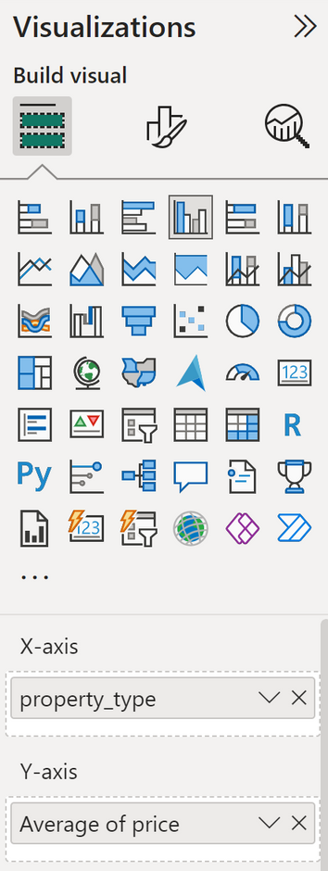
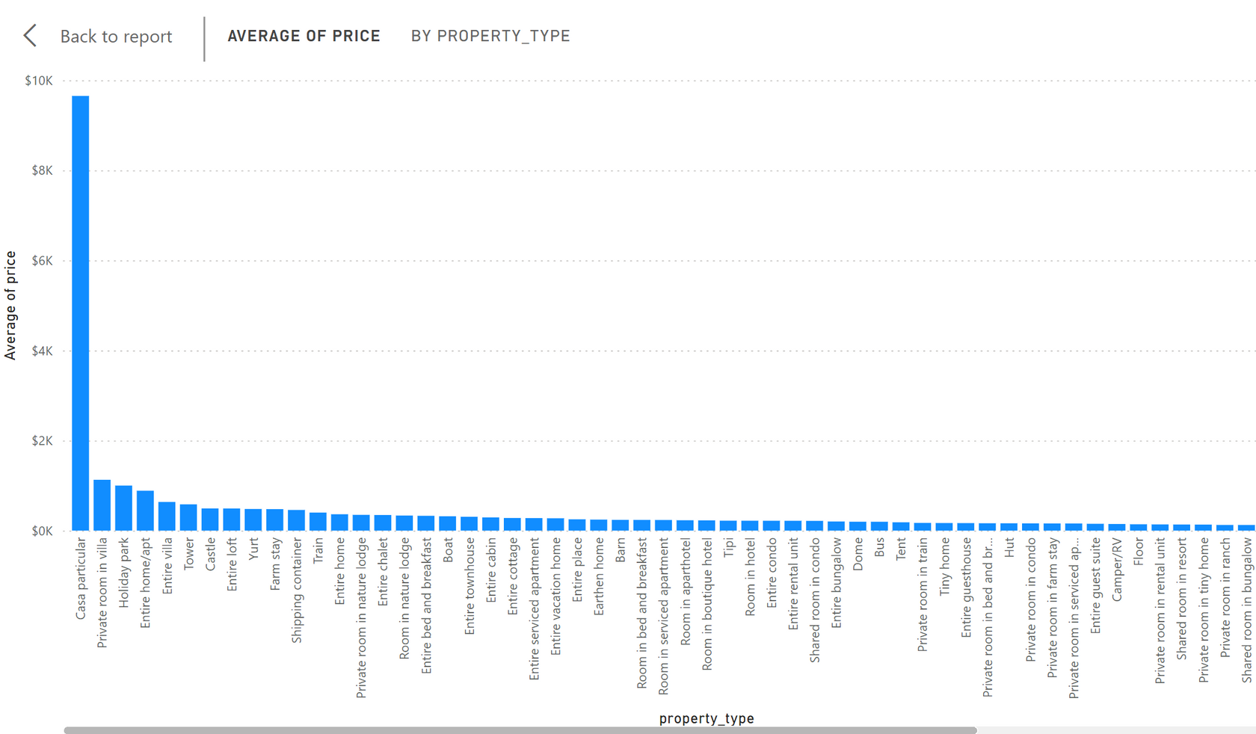
2. Pricing and Availability Analysis:
Analyze pricing trends based on property types, room types, and accommodation capacity

Slide 8
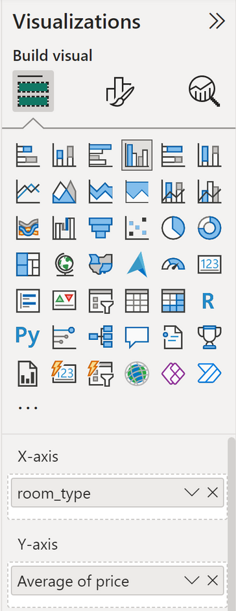
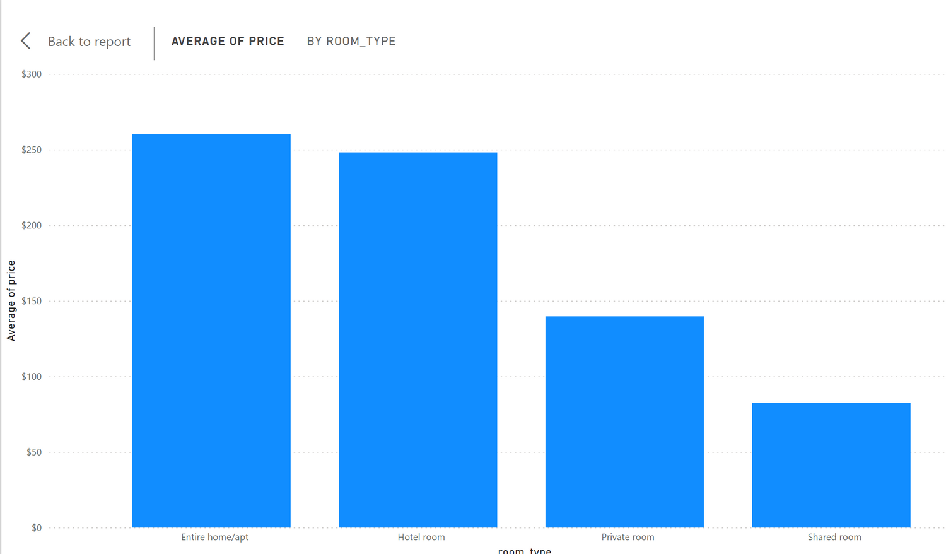
2. Pricing and Availability Analysis:
Analyze pricing trends based on property types, room types, and accommodation capacity

Slide 9
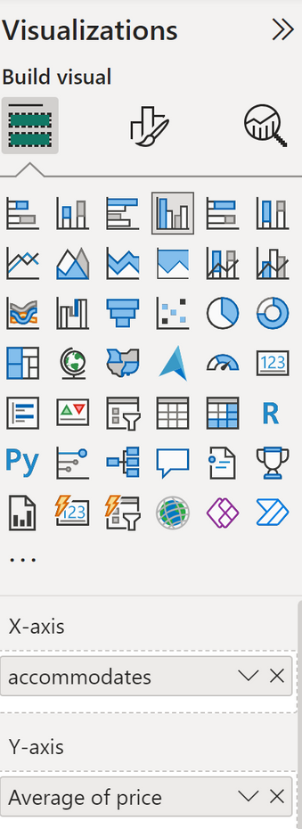
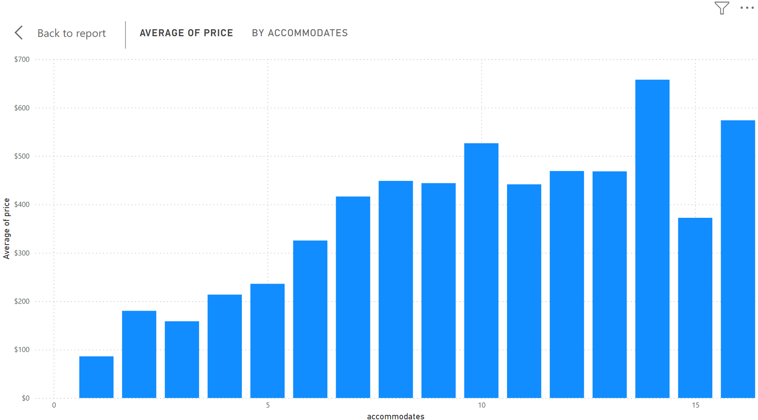
2. Pricing and Availability Analysis:
Analyze pricing trends based on property types, room types, and accommodation capacity

Slide 10
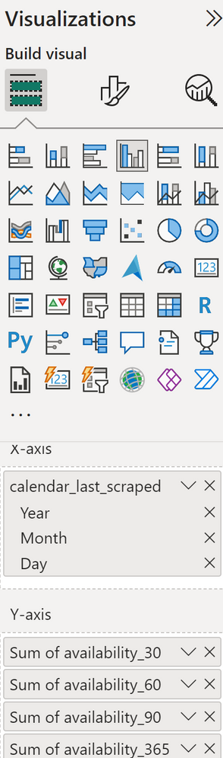
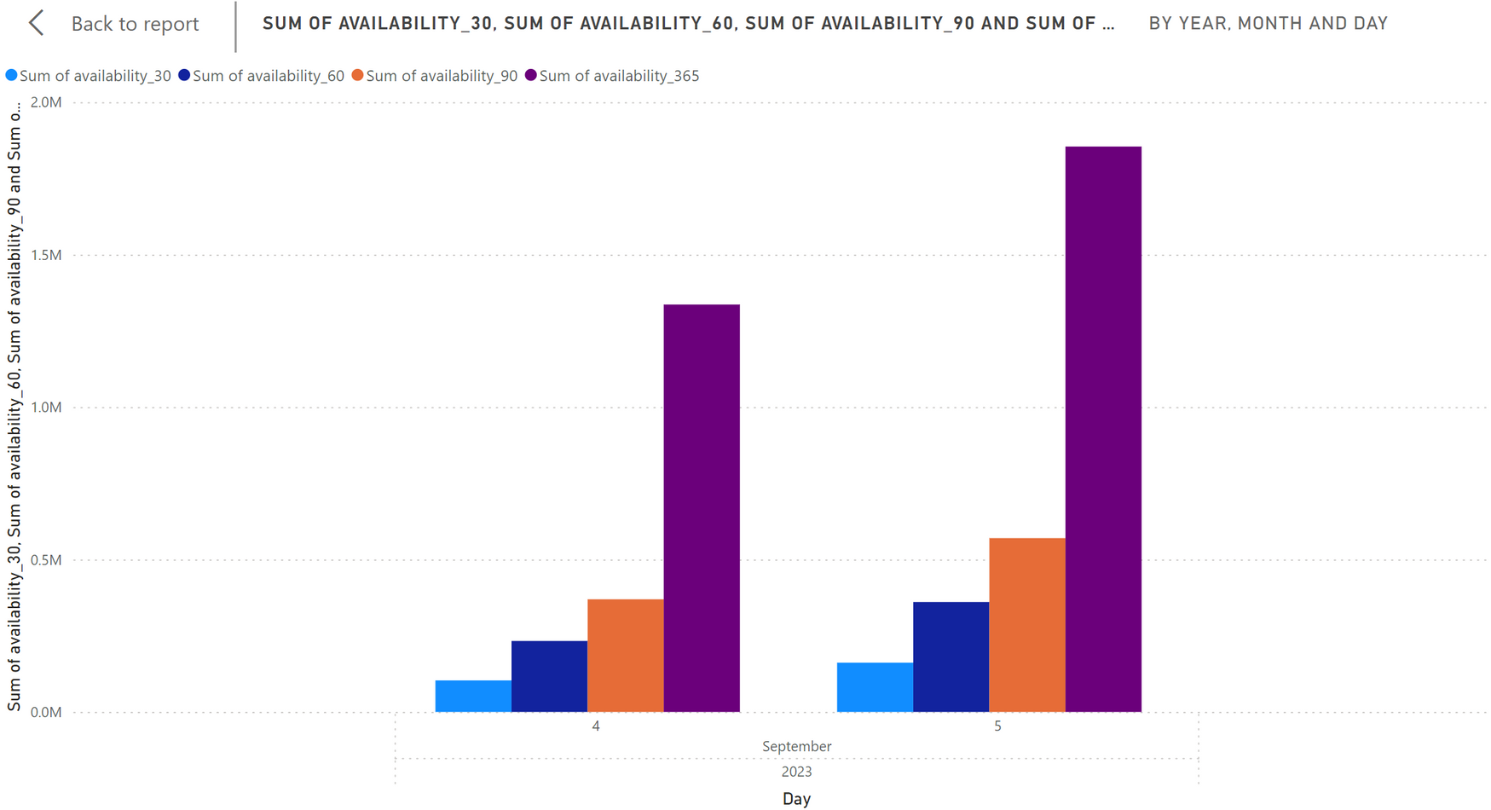
2. Pricing and Availability Analysis:
Investigate the availability of listings over time and identify peak periods

Slide 11
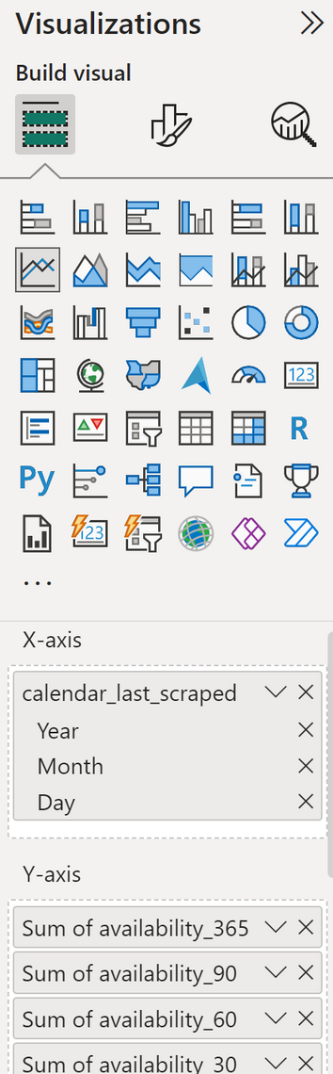
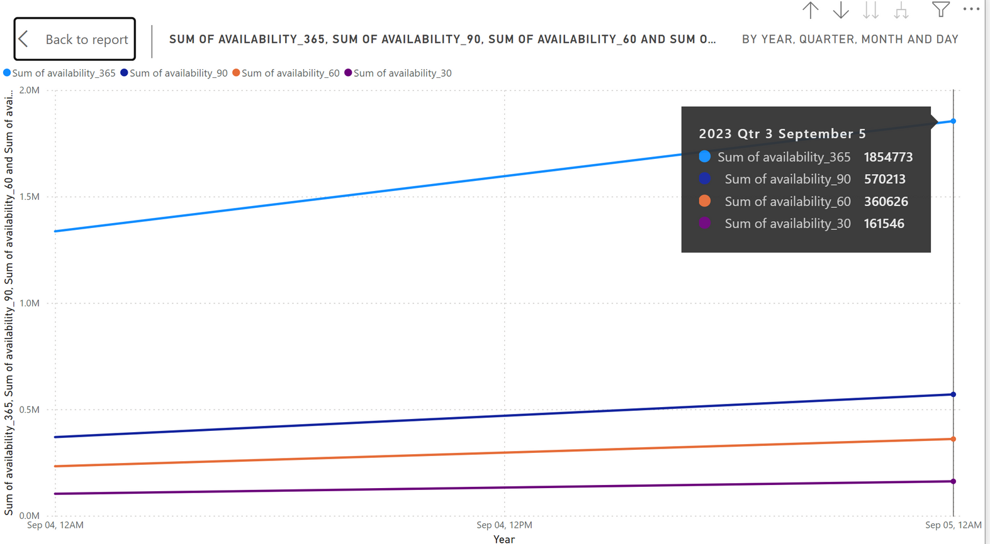

2. Pricing and Availability Analysis:
Investigate the availability of listings over time and identify peak periods
peak period

Slide 12
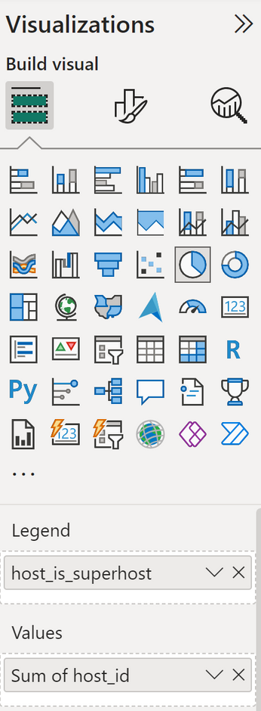
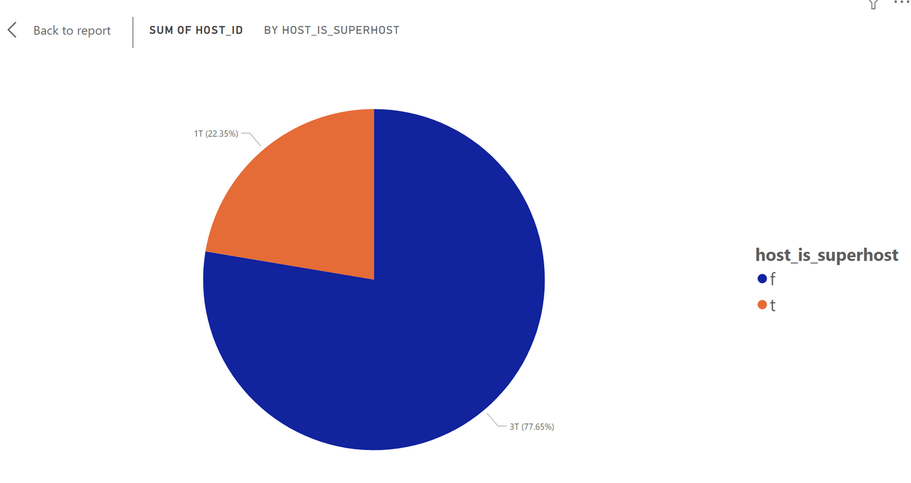
3. Host Performance:
Evaluate host characteristics, including superhost status, response times, and verification methods

Slide 13
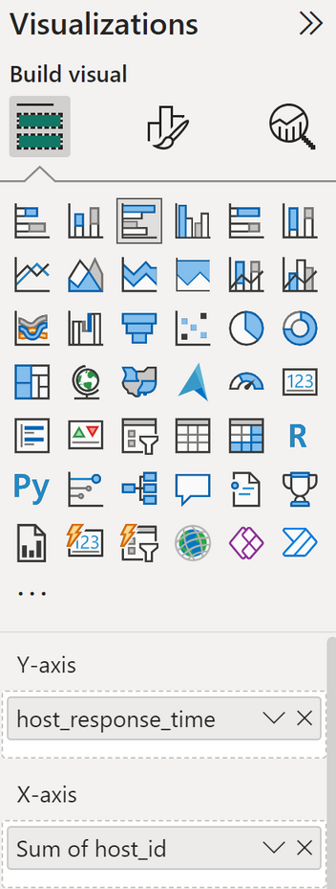
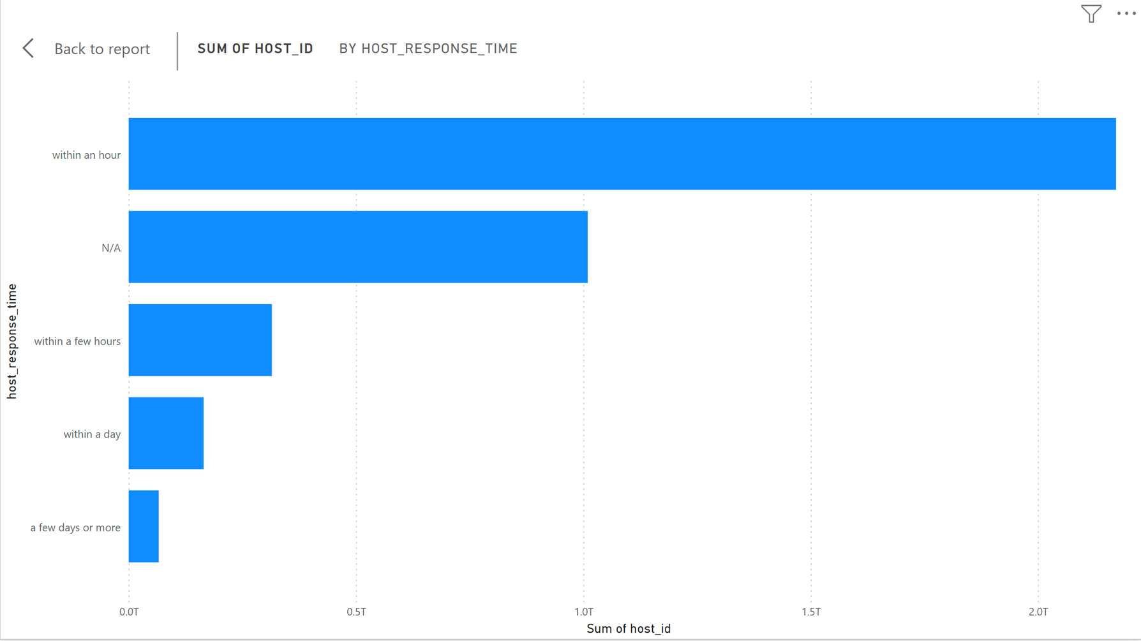
3. Host Performance:
Evaluate host characteristics, including superhost status, response times, and verification methods

Slide 14
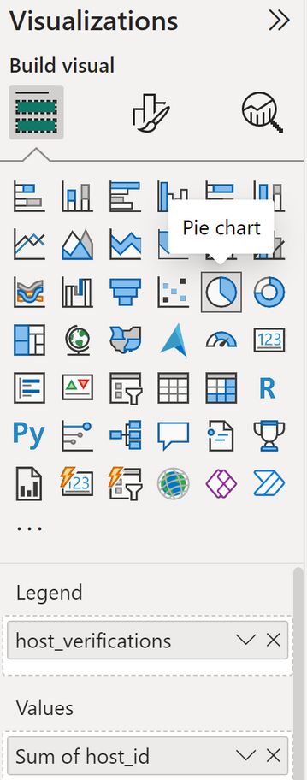
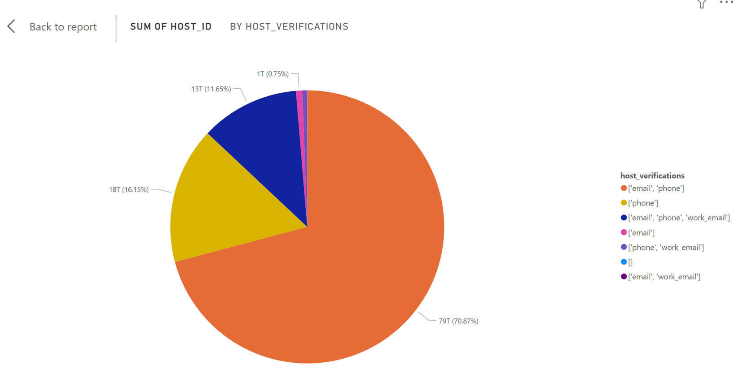
3. Host Performance:
Evaluate host characteristics, including superhost status, response times, and verification methods

Slide 15
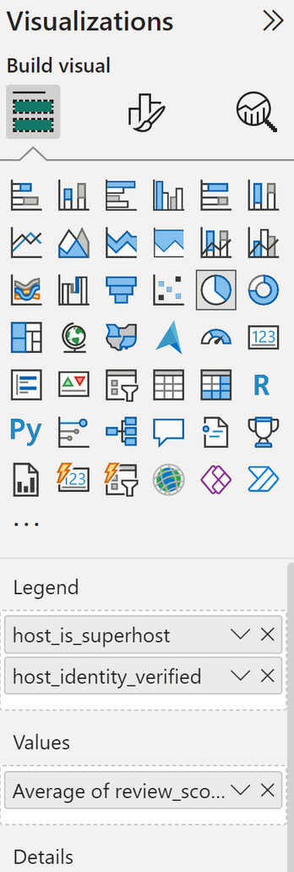
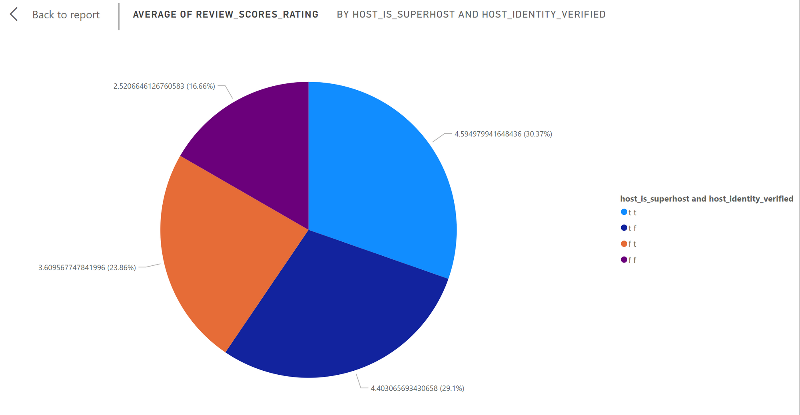
3. Host Performance:
Explore correlations between host attributes and listing performance.

Slide 16
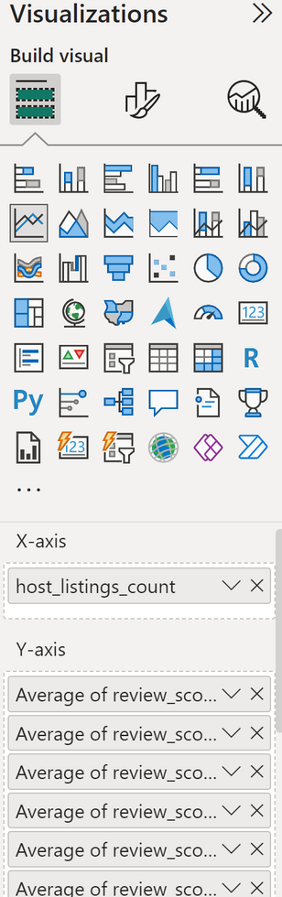
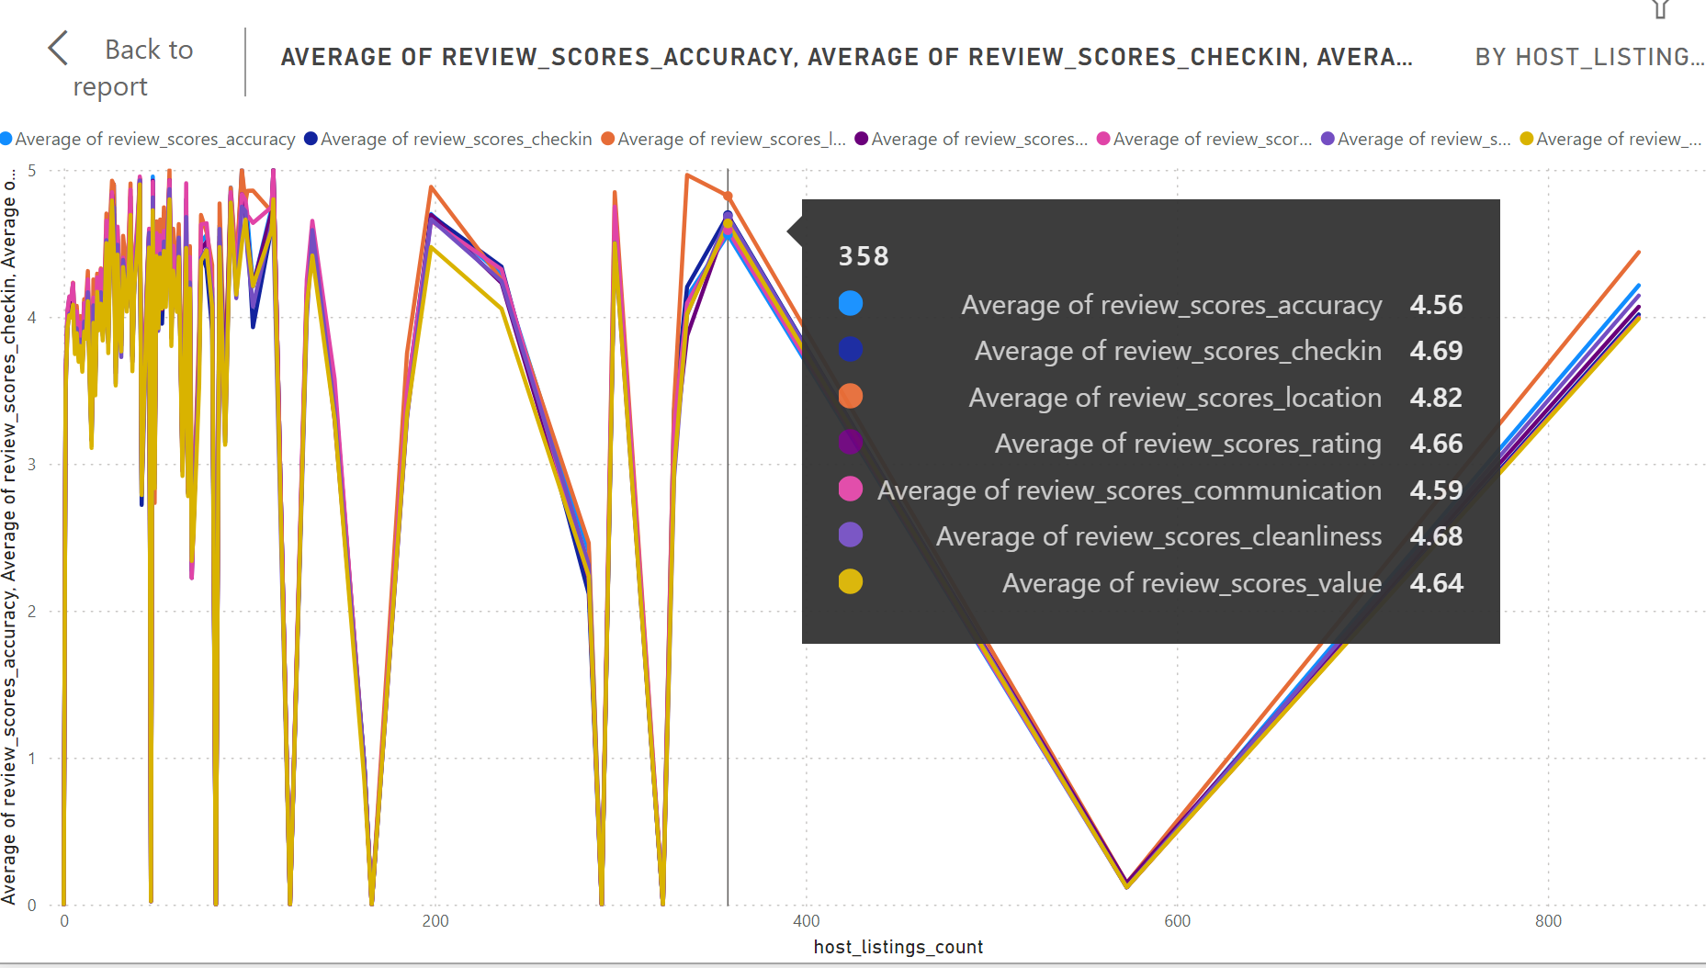
4. Review Scores and Guest Satisfaction:
Examine review scores and their impact on overall listing performance.

Slide 17
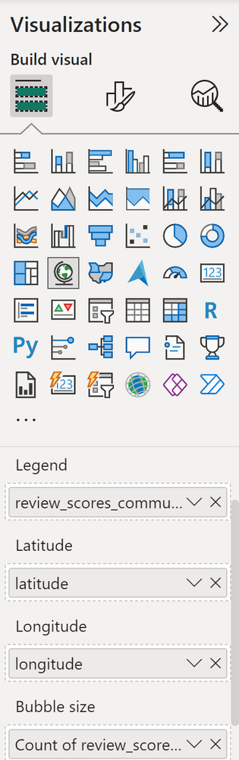
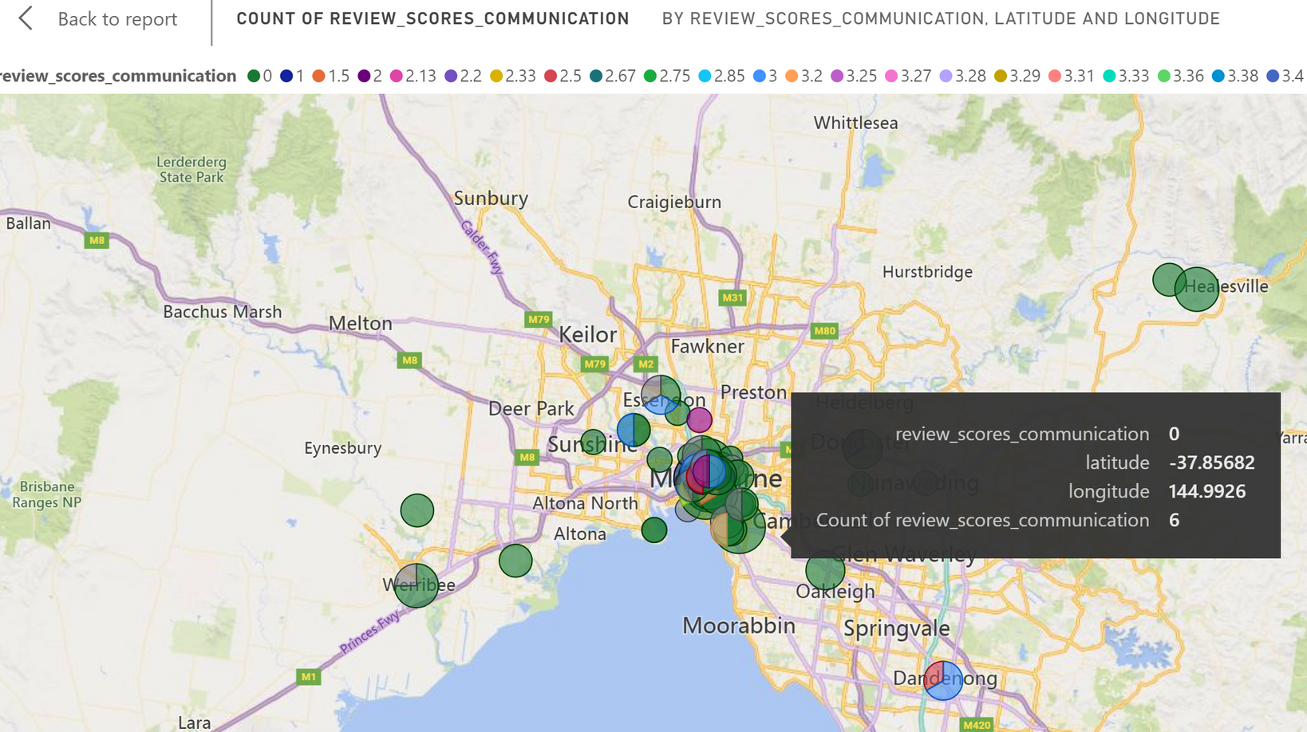
4. Review Scores and Guest Satisfaction:
Identify areas for improvement based on specific review categories.

Slide 18
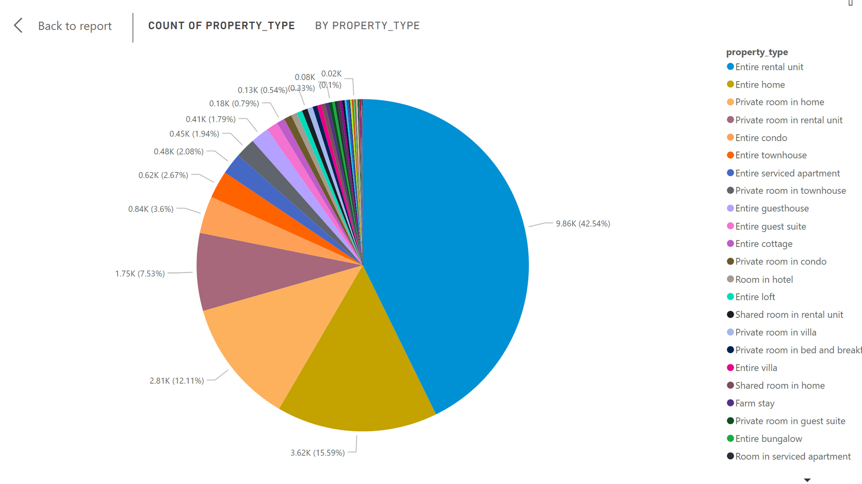
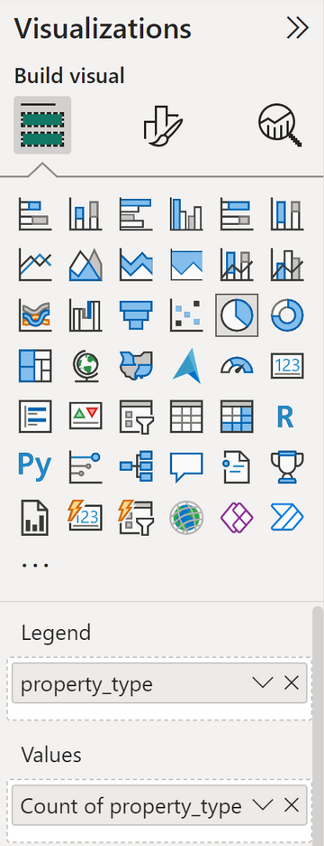
5. Property Type and Room Analysis:
Analyze the distribution of property types and room types

Slide 19
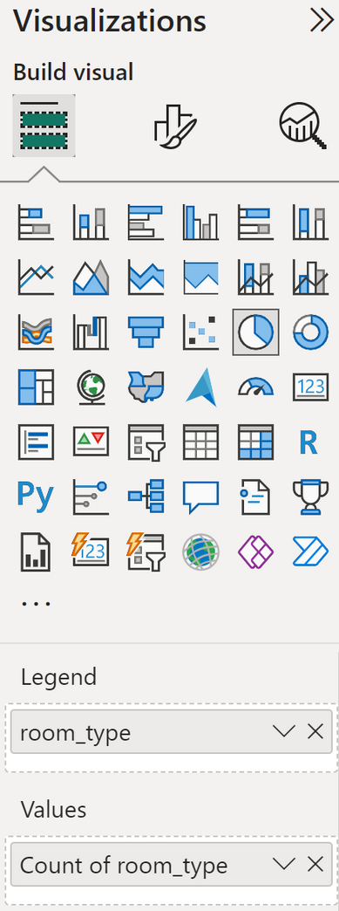
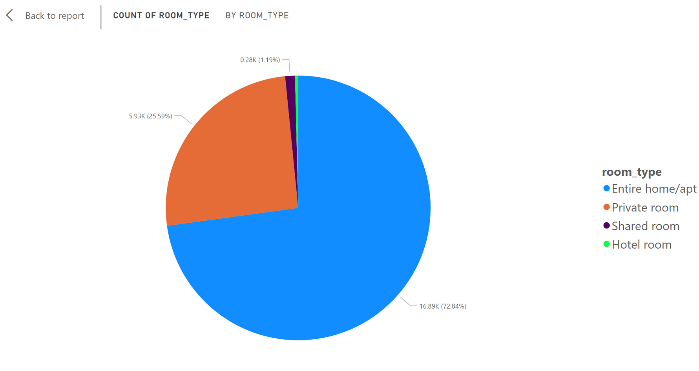
5. Property Type and Room Analysis:
Analyze the distribution of property types and room types

Slide 20
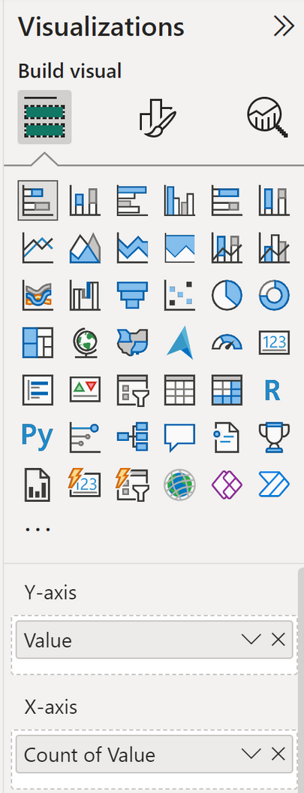
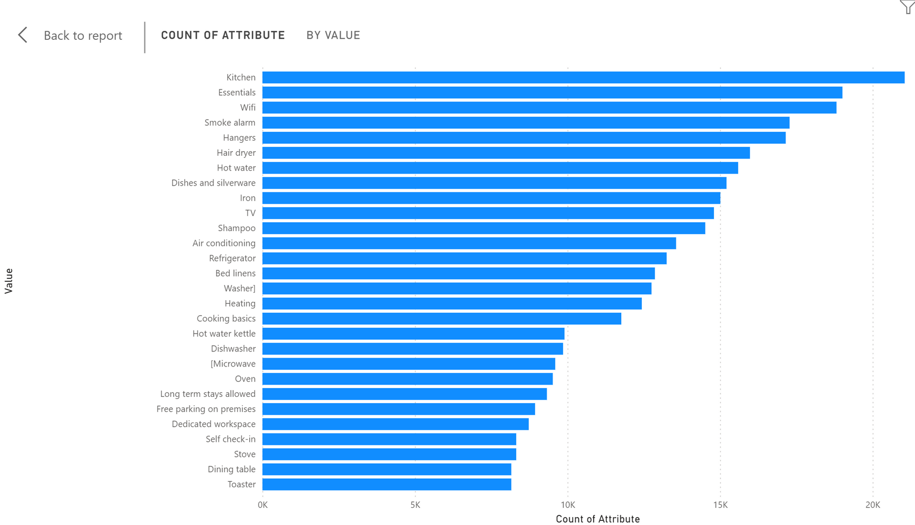
5. Property Type and Room Analysis:
Explore trends in the popularity of specific accommodation setups.

Slide 21
THANK YOU !

